Slide 1







Revolutionizing Disease Detection
Mostafa Khalid Sallam

Slide 2
INTRODUCTION
DEEP LEARNING MODELS FOR IMAGE CLASSIFICATION
Topics
INCEPTIONRESNET V2 ARCHITECTURE
A QUICK COMPARISON OF THE MODELS THAT WERE USED
PRACTICAL APPLICATION
CONCLUSION
2

Slide 3


3
INTRODUCTION

Slide 4
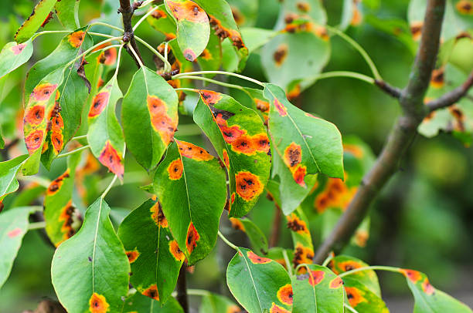
Introduction
Challenge
Threat:
Plant diseases → Crop loss, economic damage, food
Insecurity:
Traditional Methods:
Manual inspection → Slow, ineffective for early diagnosis.
4

Slide 5
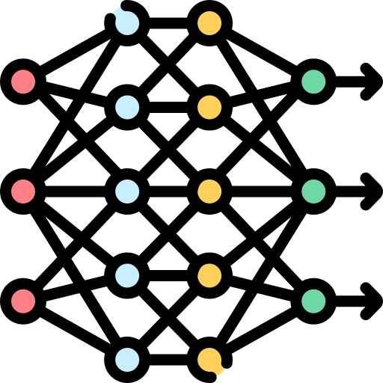
Introduction
Solution
Deep Learning (DL):
Automates detection via image analysis → Speed, accuracy, scalability.
InceptionResNetV2:
Hybrid architecture (Inception + Residual Networks).
Detects subtle symptoms → Early-stage diagnosis.
5

Slide 6
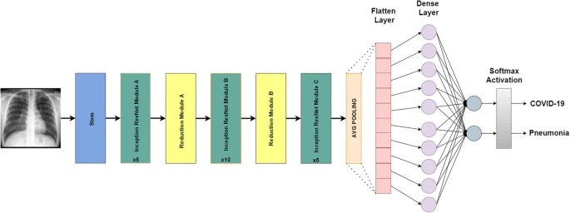
Introduction
Objective
Highlight AI’s role in bridging agricultural gaps.
Showcase InceptionResNetV2 as a game-changer for sustainable farming.
6

Slide 7
7
DEEP LEARNING MODELS FOR IMAGE CLASSIFICATION

Slide 8
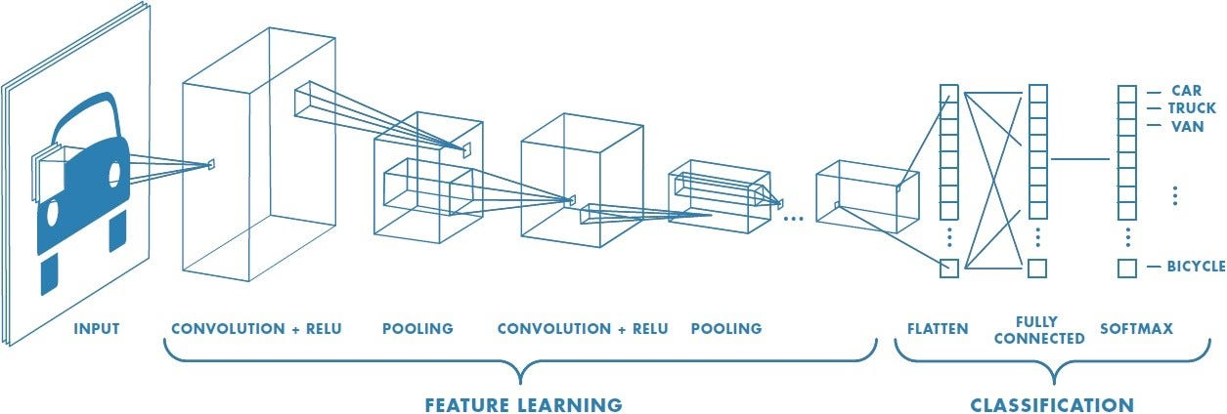
Deep learning models for image classification
Convolutional Neural Networks (CNNs)
Description
Convolutional Neural Networks (CNNs) are a specialized type of deep learning model designed to analyze visual data (as Images). A typical CNN consists of:
Convolutional layers
Pooling layers
Fully connected layers
8

Slide 9
Deep learning models for image classification
9

Slide 10
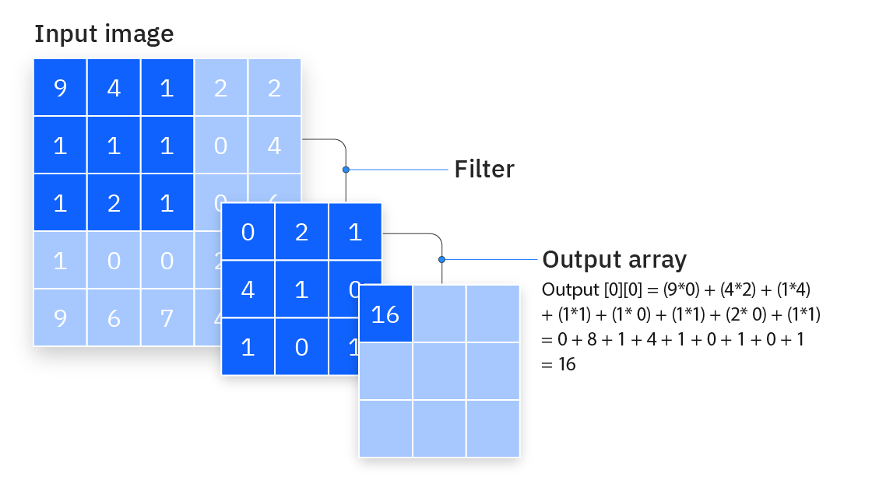
Deep learning models for image classification
🔹 1. Convolution Layer
How it works
The convolution layer applies a set of filters (kernels) to the input image.
Each filter slides across the image, performing a dot product between the filter and local regions of the image to produce a feature map.
10

Slide 11
Deep learning models for image classification
🔹 1. Convolution Layer
Filters & Output Depth
Role: Each filter extracts unique features (edges, textures).
Example: 3 filters → 3 feature maps → Output depth = 3.
11

Slide 12
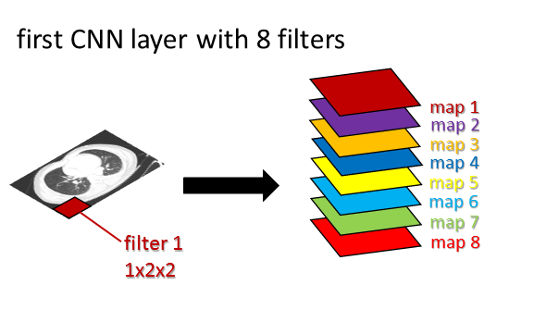
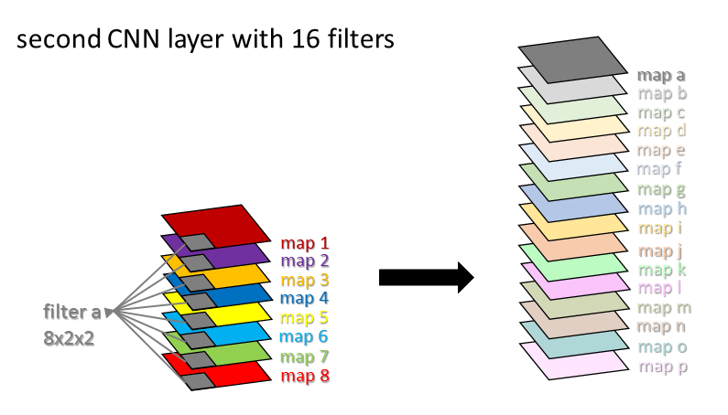
Deep learning models for image classification
12

Slide 13
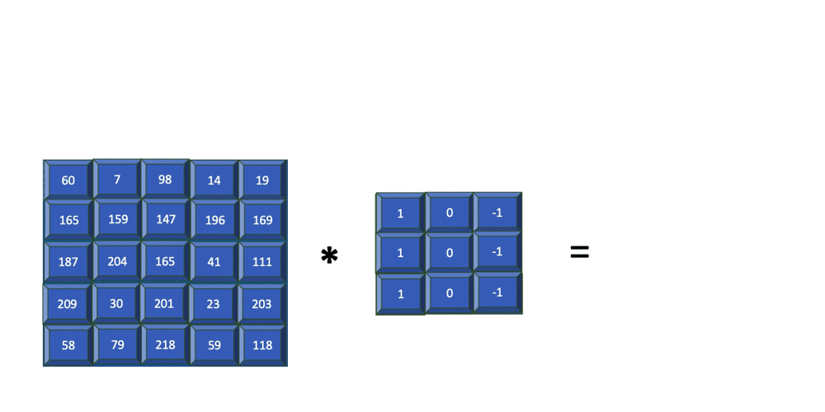
Deep learning models for image classification
13

Slide 14
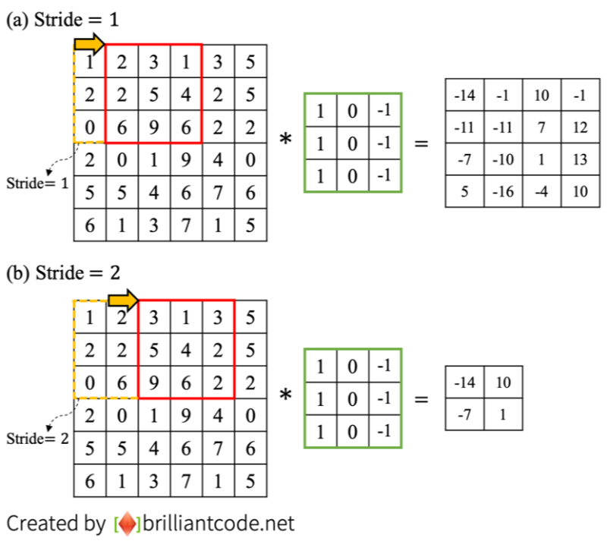
Deep learning models for image classification
🔹 1. Convolution Layer
2. Stride & Output Size
Definition: Steps the kernel takes across the input (e.g., stride=1 or 2).
Impact: Larger stride → Smaller output size.
Example: Stride=2 halves output dimensions.
14

Slide 15
Deep learning models for image classification
15

Slide 16
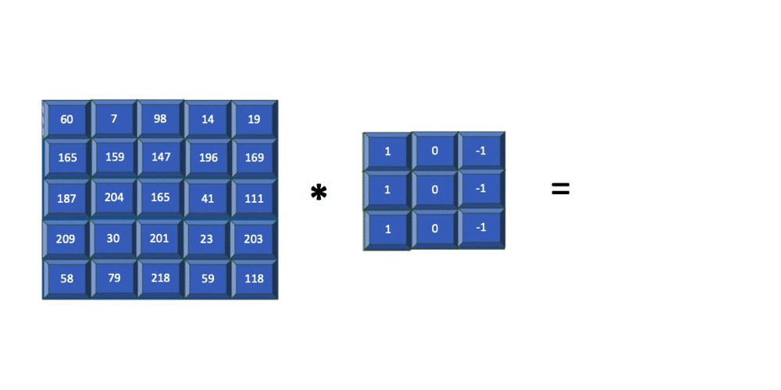
Deep learning models for image classification
16

Slide 17
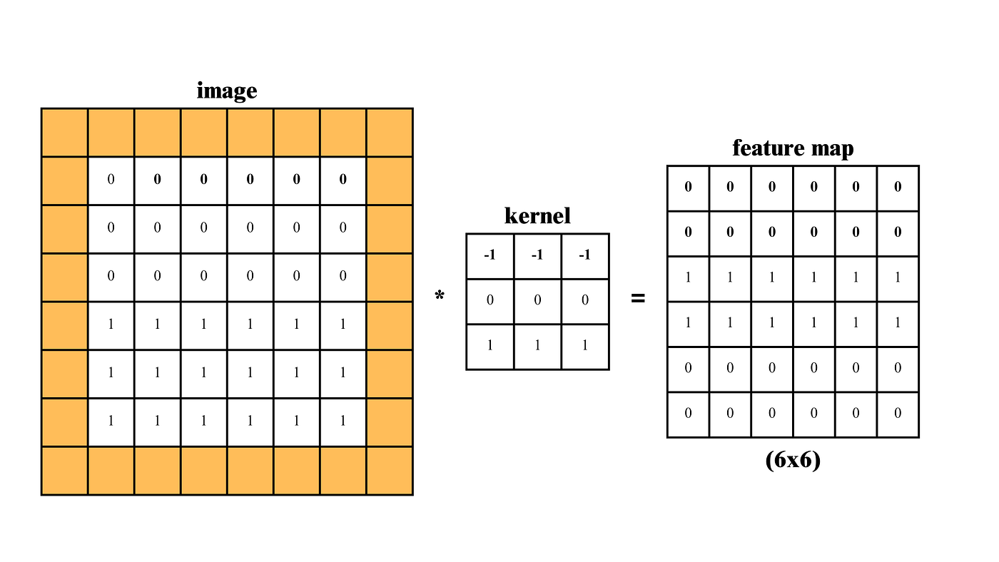
Deep learning models for image classification
🔹 1. Convolution Layer
3.Padding Types:
Valid: No padding → Output ≤ input.
Same: Output = input (adds zeros).
Full: Output > input (maximal zero padding).
17

Slide 18
Deep learning models for image classification
18

Slide 19
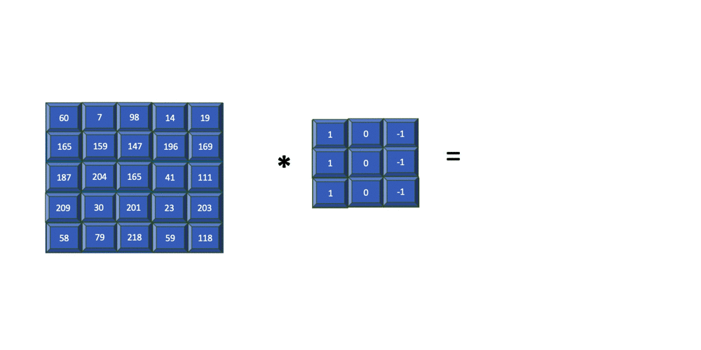
Deep learning models for image classification
19

Slide 20
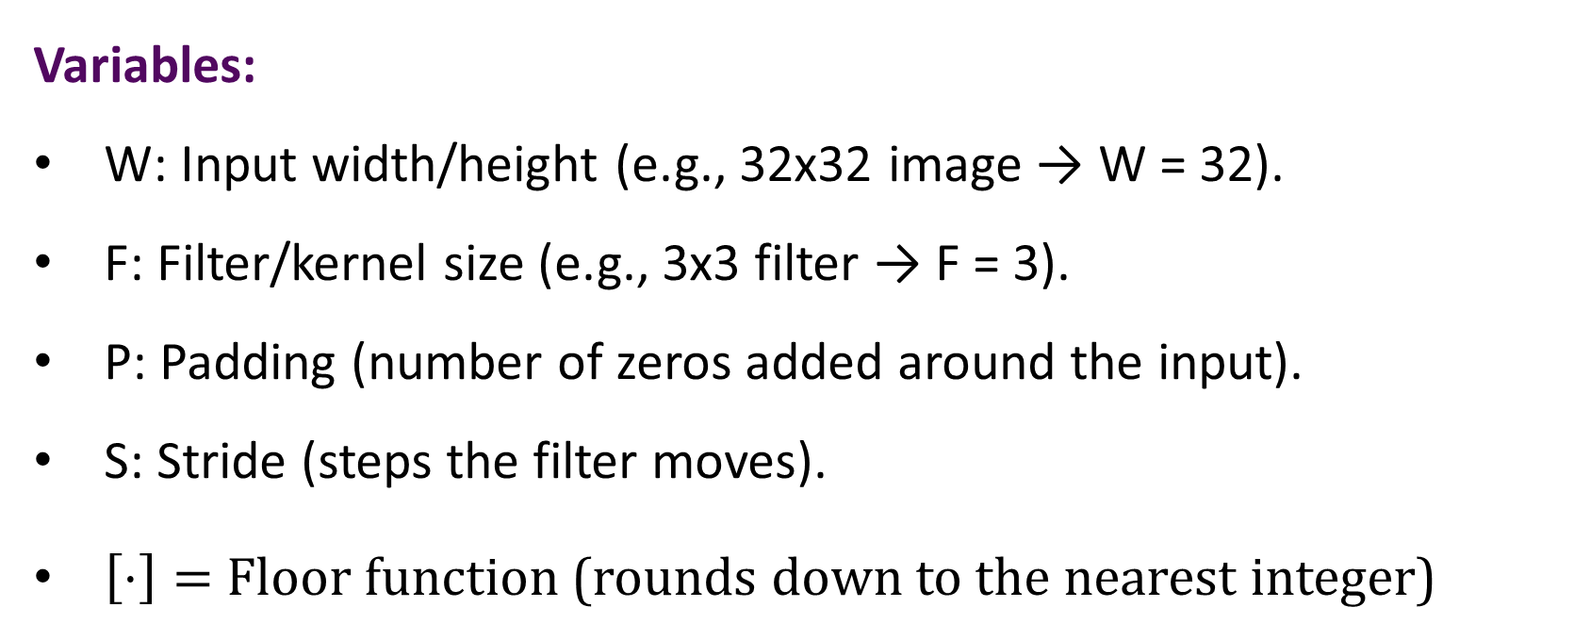
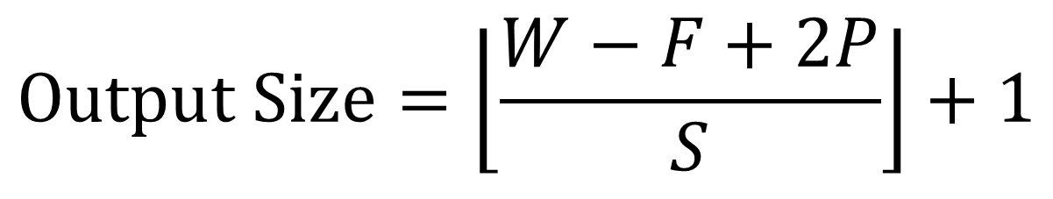
Deep learning models for image classification
🔹 1. Convolution Layer
Variables:
W: Input width/height (e.g., 32x32 image → W = 32).
F: Filter/kernel size (e.g., 3x3 filter → F = 3).
P: Padding (number of zeros added around the input).
S: Stride (steps the filter moves).
$\left[⋅\right]=$ Floor function (rounds down to the nearest integer)
Output size in a Convolutional Neural Network (CNN)
$$Output Size=\left\lfloor \frac{W−F+2P}{S}\right\rfloor +1$$
20

Slide 21
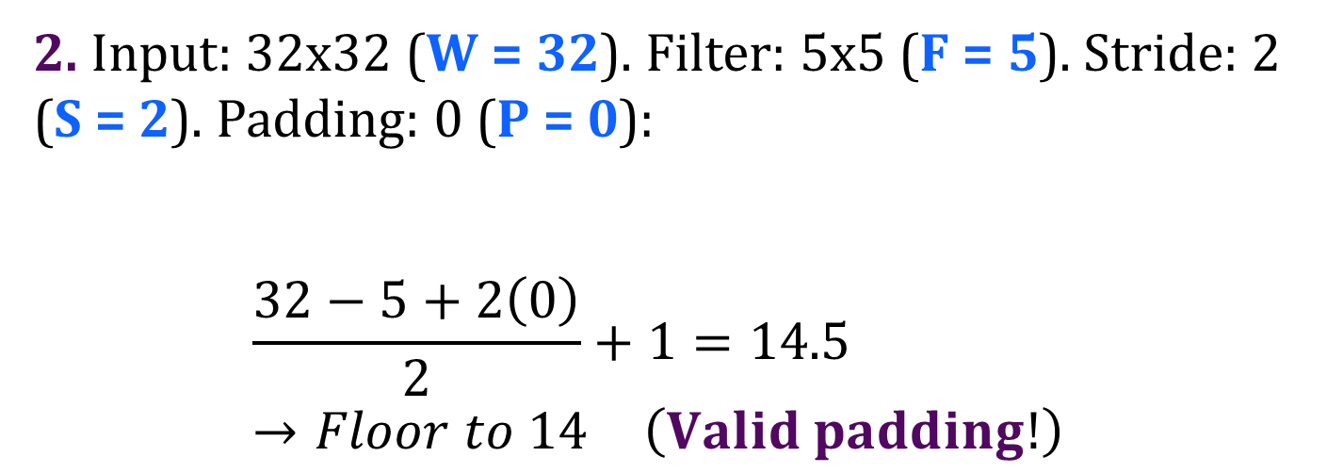
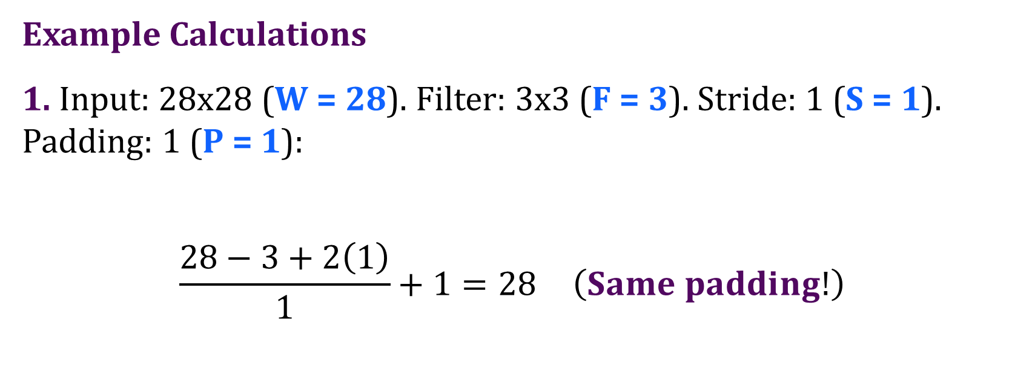
Deep learning models for image classification
🔹 1. Convolution Layer
Output size in a Convolutional Neural Network (CNN)
Example Calculations
1. Input: 28x28 (W = 28). Filter: 3x3 (F = 3). Stride: 1 (S = 1). Padding: 1 (P = 1):
$$\frac{28−3+2\left(1\right)}{1}+1=28 \left(Same padding!\right)$$
2. Input: 32x32 (W = 32). Filter: 5x5 (F = 5). Stride: 2 (S = 2). Padding: 0 (P = 0):
$$\frac{32−5+2\left(0\right)}{2}+1=14.5→Floor to 14 \left(Valid padding!\right)$$
21

Slide 22
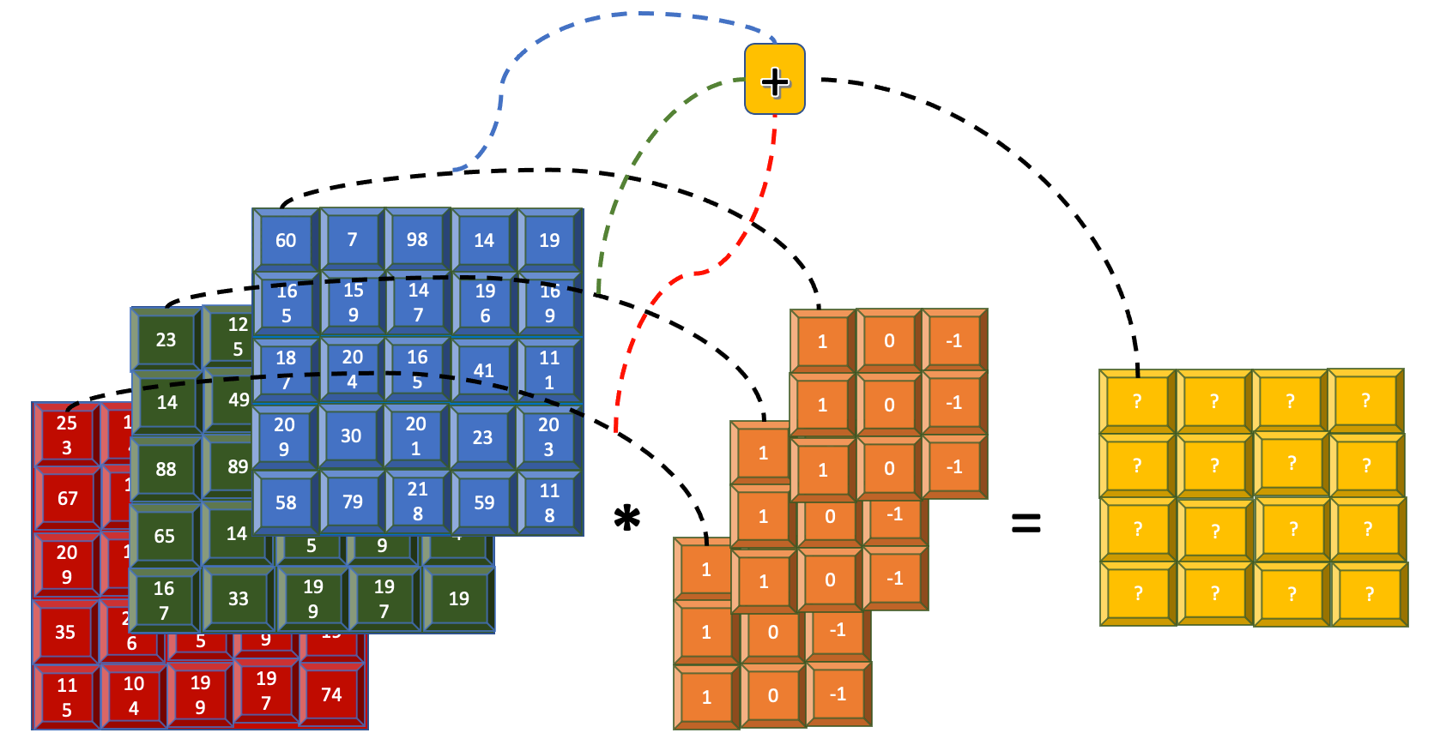
Deep learning models for image classification
🔹 1. Convolutions applied over the RGB channels
22

Slide 23
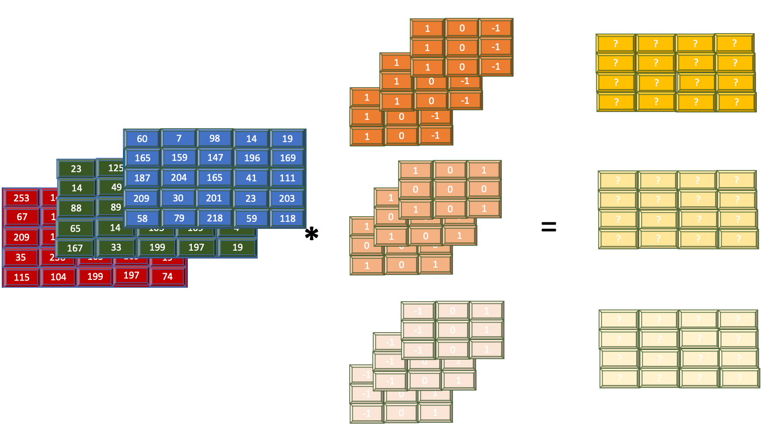
Deep learning models for image classification
🔹 1. Convolutions applied over the RGB channels
23

Slide 24
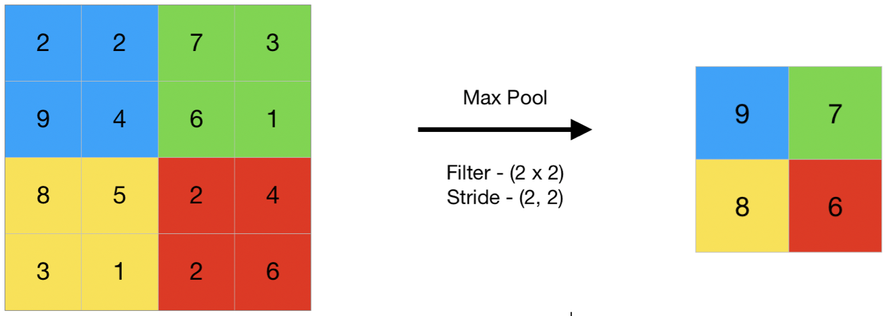
Deep learning models for image classification
🔹 2. Max Pooling Layer
How it works
Mechanism:
Slides a window (e.g., 2×2) over feature maps → selects maximum value in each region.
24

Slide 25
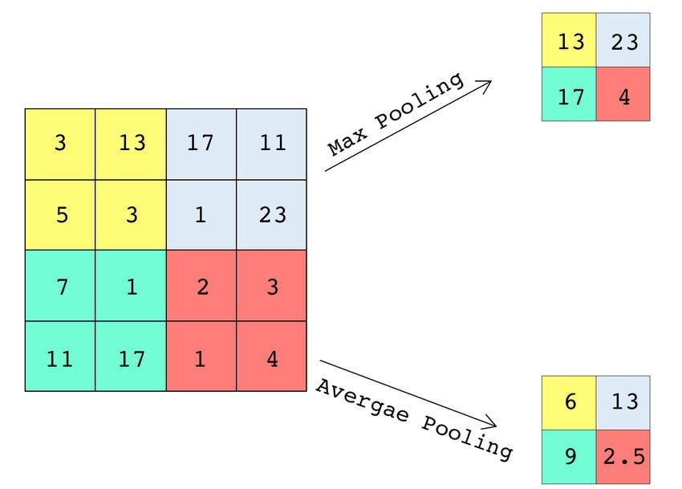
Deep learning models for image classification
🔹 2. Max Pooling Layer
Purpose
Down sampling: Reduces spatial dimensions (e.g., 4x4 → 2x2).
Efficiency: Lowers computational load.
Translation Invariance: Focuses on strongest features (e.g., edges, patterns), regardless of exact location.
25

Slide 26
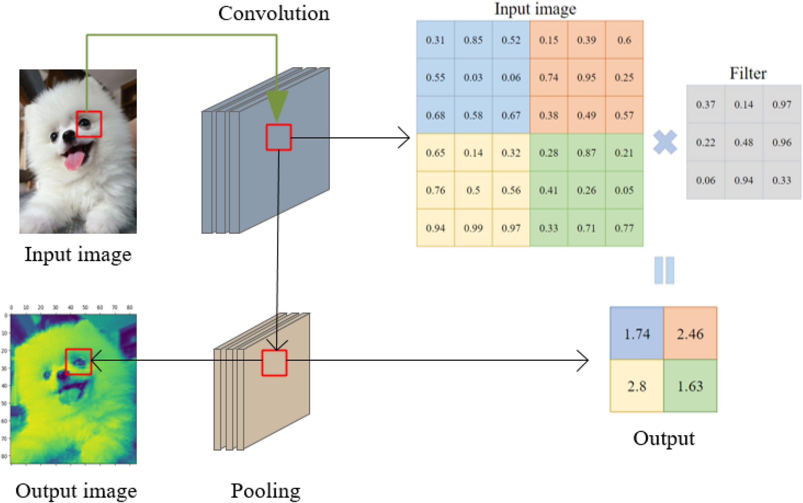
Deep learning models for image classification
26

Slide 27
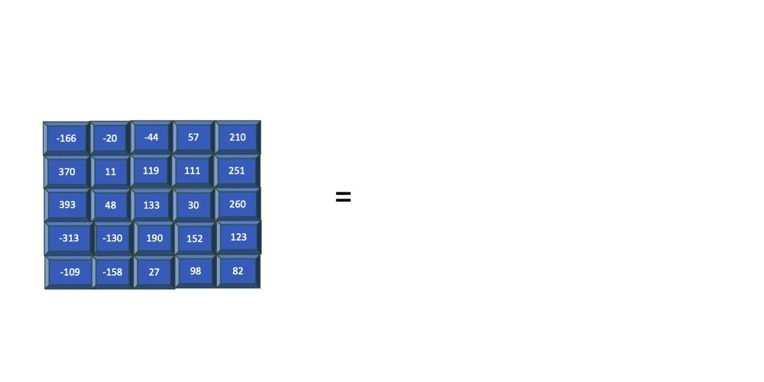
Deep learning models for image classification
27

Slide 28

Deep learning models for image classification
🔹 3. Flatten Layer
How it works
The flatten layer converts the 2D feature maps (after convolution and pooling) into a 1D vector.
28

Slide 29
Deep learning models for image classification
🔹 3. Flatten Layer
Purpose
Prepares the data for the fully connected layers (which act like a traditional neural network classifier).
29

Slide 30
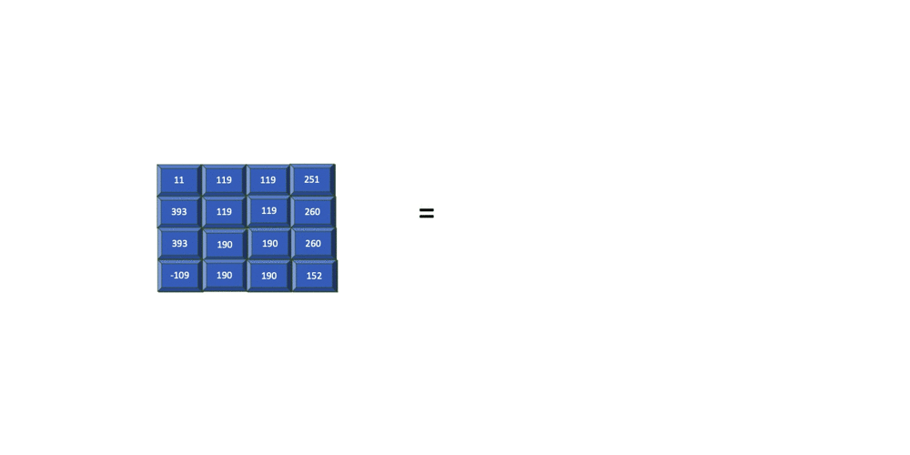
Deep learning models for image classification
30

Slide 31
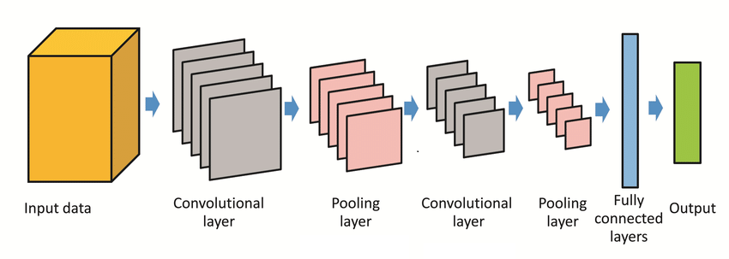
Deep learning models for image classification
31

Slide 32
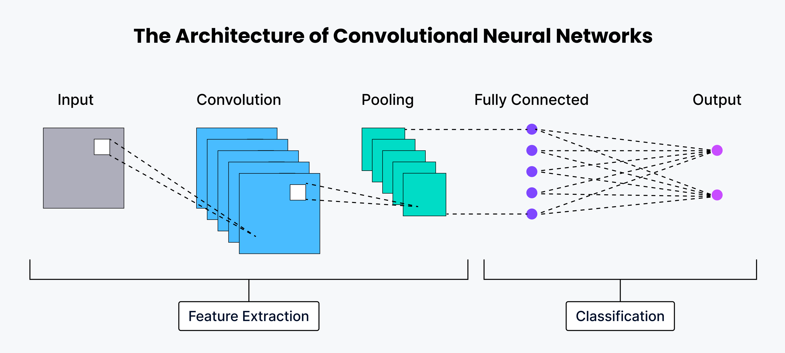
Deep learning models for image classification
32

Slide 33
33
INCEPTIONRESNET V2 ARCHITECTURE

Slide 34
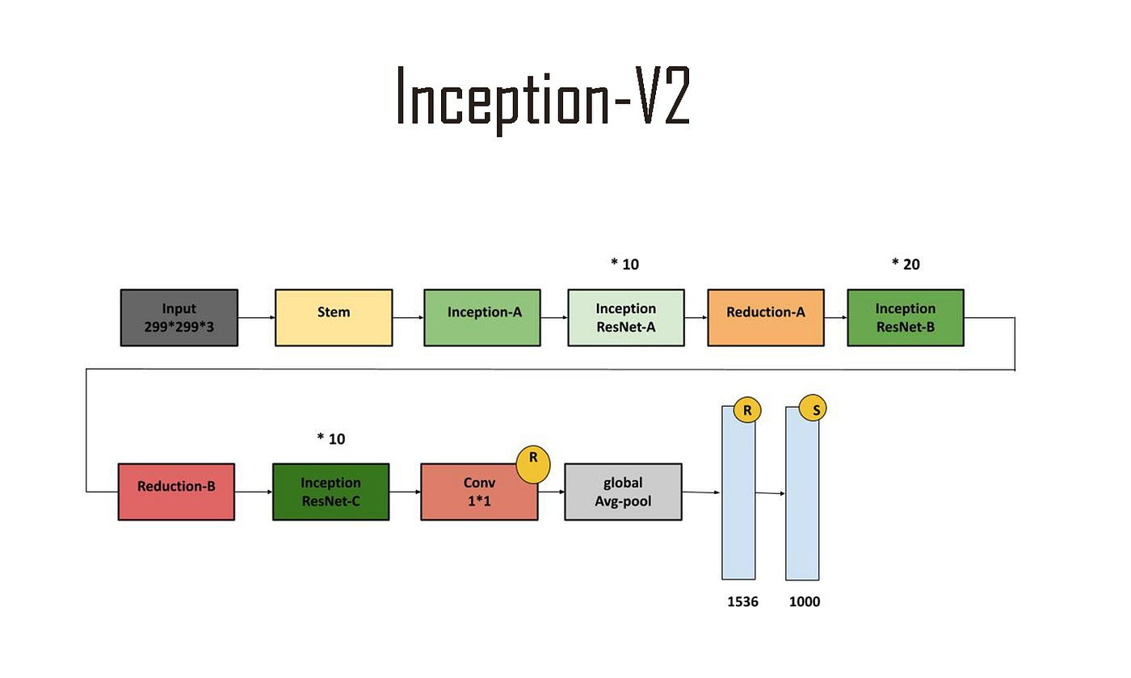
Deep learning models for image classification
InceptionResNetV2 Architecture
Description
InceptionResNetV2 is a deep convolutional neural network that combines:
Inception modules
Residual connections
Number of Layers: Approximately 572 layers, making it one of the deepest CNNs available.
Input Size: Typically 299 × 299 pixels.
34

Slide 35
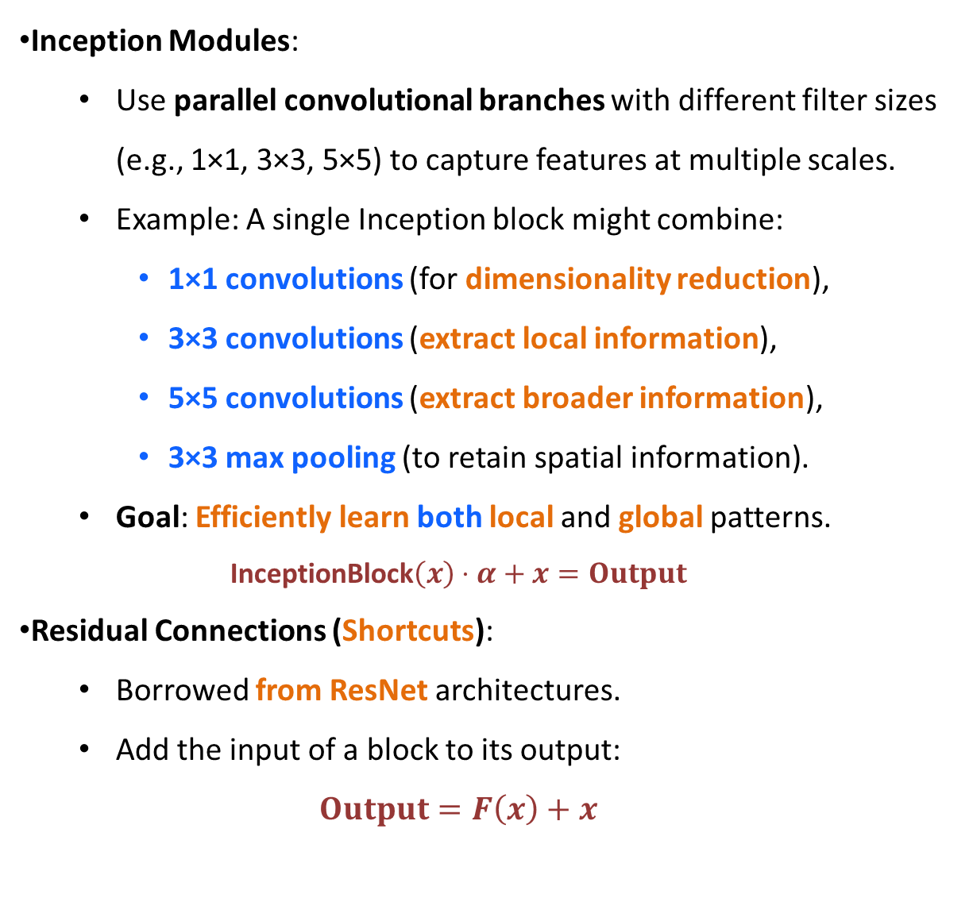
Deep learning models for image classification
Inception Modules:
Use parallel convolutional branches with different filter sizes (e.g., 1×1, 3×3, 5×5) to capture features at multiple scales.
Example: A single Inception block might combine:
1×1 convolutions (for dimensionality reduction),
3×3 convolutions (extract local information),
5×5 convolutions (extract broader information),
3×3 max pooling (to retain spatial information).
Goal: Efficiently learn both local and global patterns.
$$\text{InceptionBlock}\left(x\right)⋅α+x=Output$$
Residual Connections (Shortcuts):
Borrowed from ResNet architectures.
Add the input of a block to its output:
$$Output=F\left(x\right)+x$$
35

Slide 36
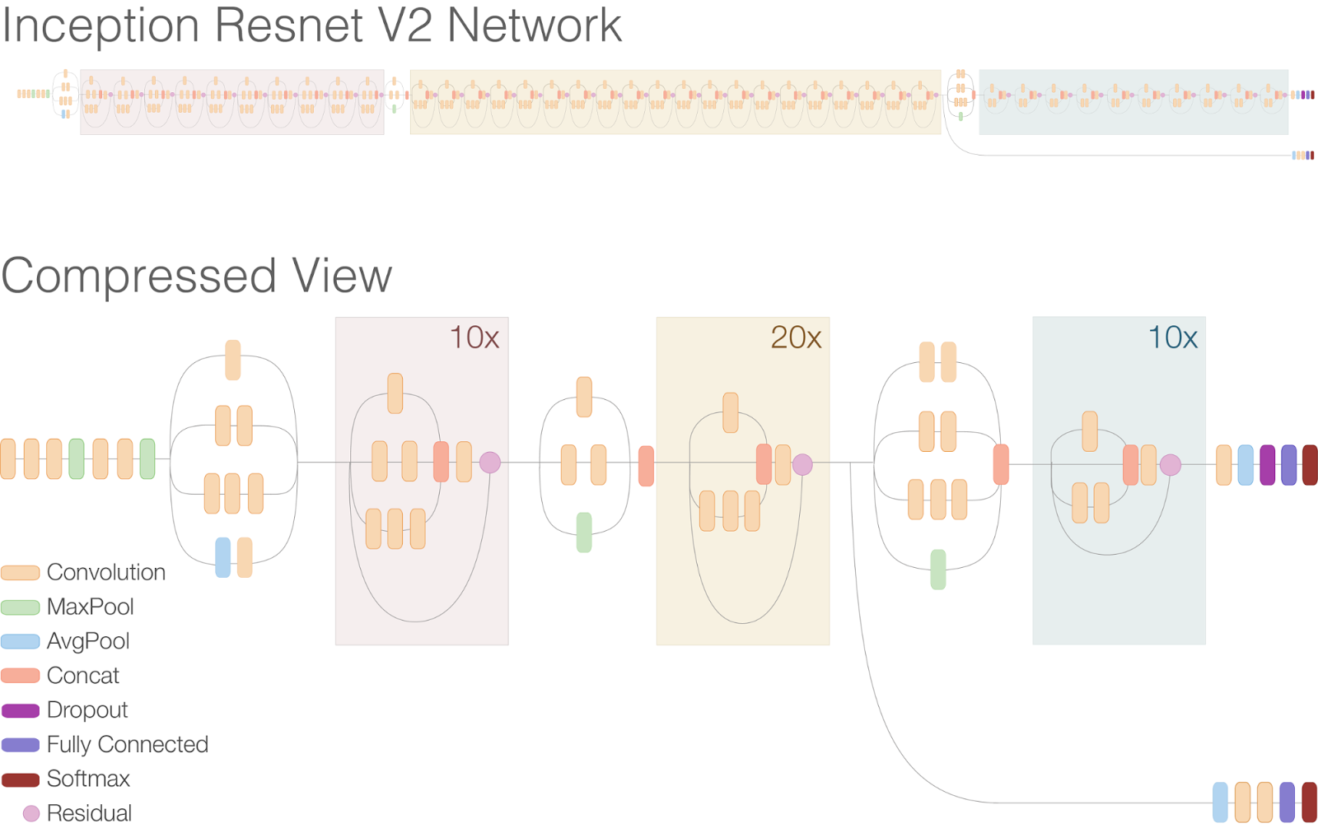
Deep learning models for image classification
Layer Count:
Total Layers: ~572 layers (including convolutional, pooling, batch norm, and fully connected layers).
Breakdown:
164 convolutional layers (with varying filter sizes),
12 Inception-ResNet modules (complex multi-branch blocks),
2 stem blocks (initial feature extractors),
Auxiliary classifiers (for training stabilization).
36

Slide 37
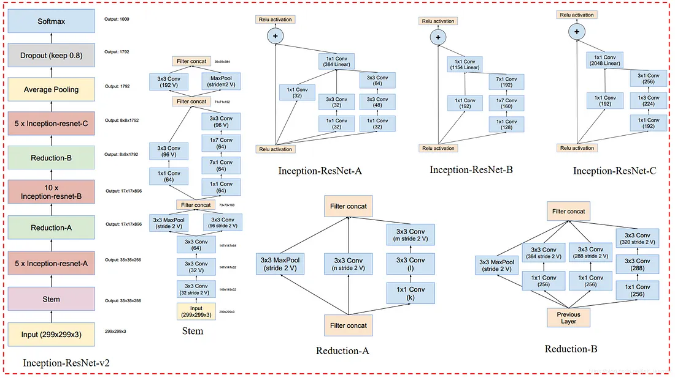
Deep learning models for image classification
37

Slide 38
Deep learning models for image classification
InceptionResNetV2 Architecture
Strengths
Learns both fine-grained and high-level features.
Faster convergence during training due to residual paths.
High accuracy in complex classification tasks.
Limitations
High computational cost and memory usage.
Requires large datasets and powerful GPUs for effective training.
38

Slide 39
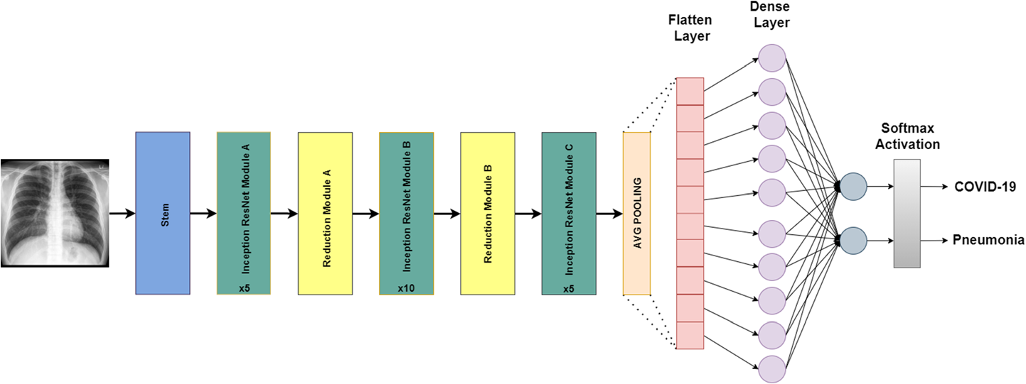
Deep learning models for image classification
InceptionResNetV2 Architecture
Common Use Cases
Medical image analysis (e.g., COVID-19 detection)
Fine-grained classification tasks (e.g., plant disease detection)
Industrial inspection and defect detection.
39

Slide 40
40
A QUICK COMPARISON OF THE MODELS THAT WERE USED

Slide 41
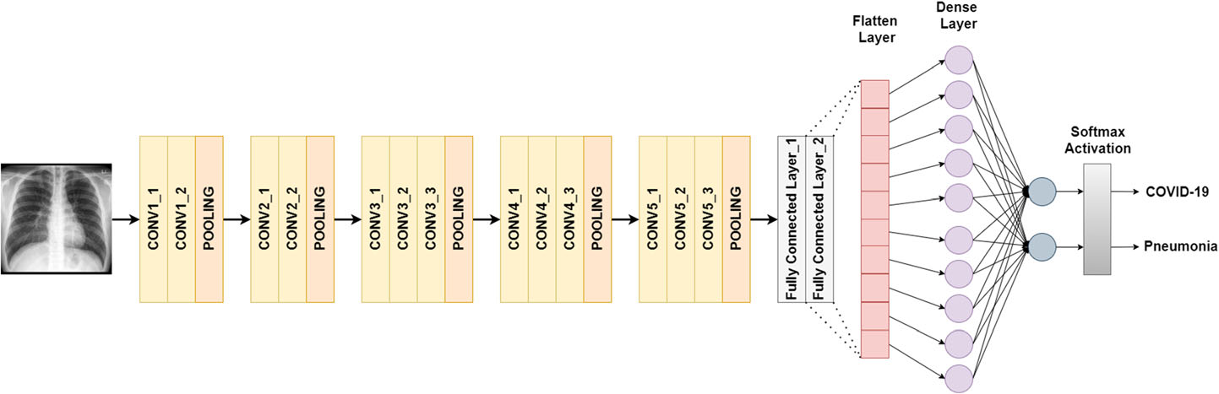
A quick comparison of the models that were used
VGG16 architecture designed for binary classification
41

Slide 42
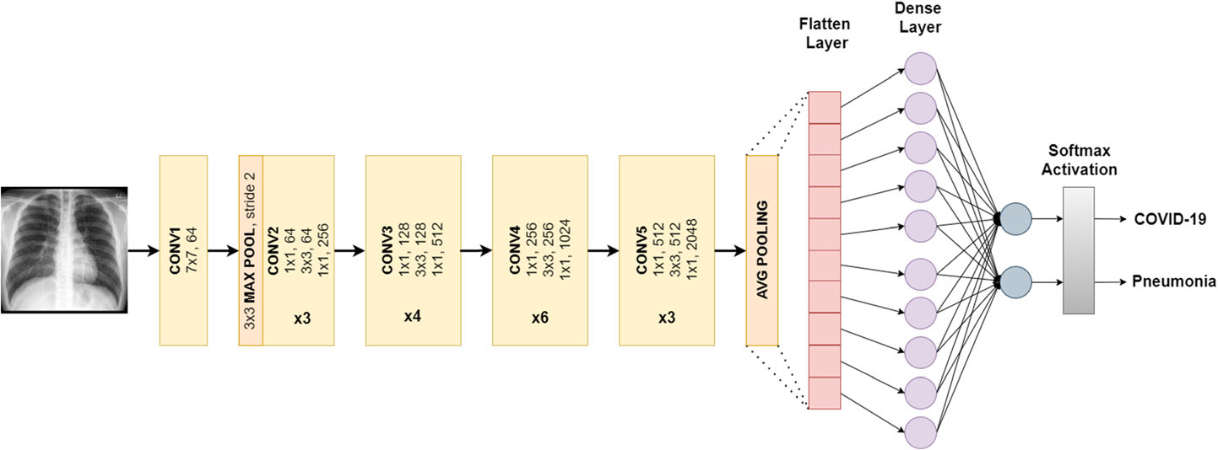
A quick comparison of the models that were used
ResNet50 architecture designed for binary classification
42

Slide 43
A quick comparison of the models that were used
Inception-ResNet-V2 architecture designed for binary classification
43

Slide 44
A quick comparison of the models that were used
Model | Number of Layers | Strengths | Limitations | Common Use Cases
InceptionResNetV2 | ~572 | Captures multi -scale and abstract features- Residual connections improve training stability- High classification accuracy | - Very high computational and memory cost- Requires large datasets and powerful GPUs | Medical image analysis, plant disease detection
ResNet50 | 50 | - Efficient depth with residual connections- Good performance on moderate hardware | - May miss very fine-grained features- Not ideal for highly detailed textures | General image classification, diagnostics
VGG16 | 16 | - Easy to understand and implement- Solid baseline for model comparison | - Large number of parameters (~138M)- Prone to overfitting- Slow training | Academic demos, basic visual recognition tasks
Custom CNN | 5–15 (typical) | - Lightweight and fast- Fully adaptable to specific tasks and limited hardware | - Lower accuracy in complex domains- Limited generalization capabilities | Mobile apps, embedded systems, real-time detection
44

Slide 45
45
PRACTICAL APPLICATION

Slide 46
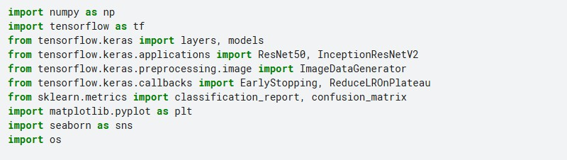
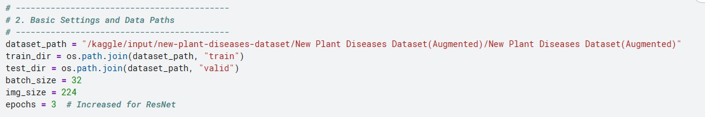
Practical application
46

Slide 47
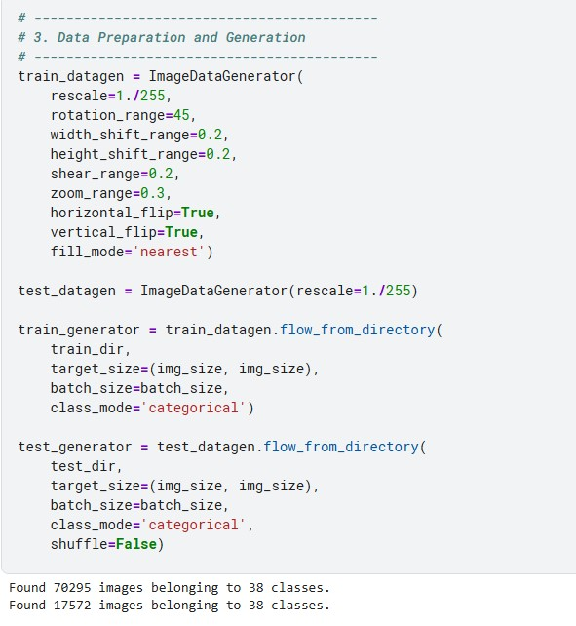
Practical application
Output
47

Slide 48
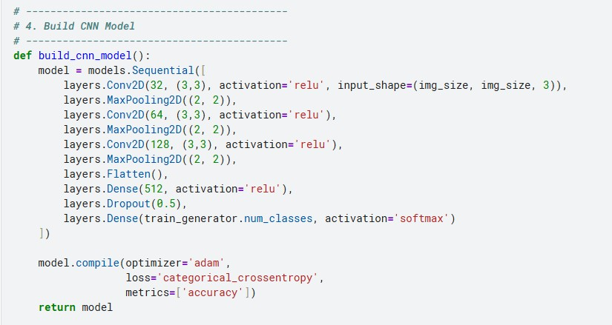
Practical application
48

Slide 49
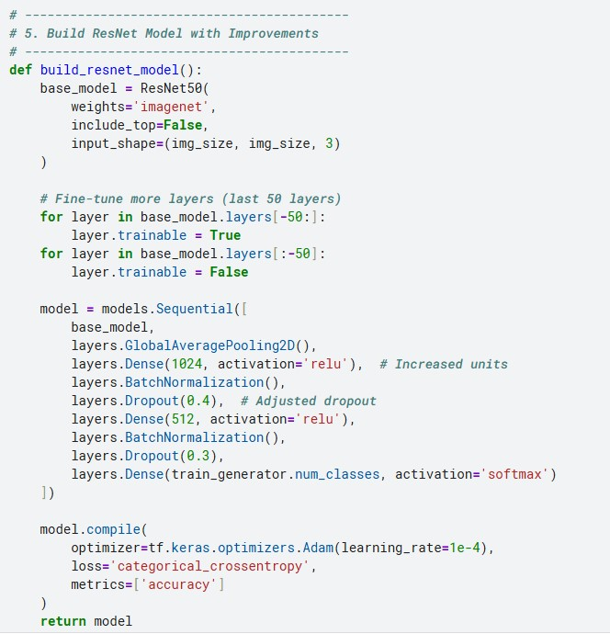
Practical application
49

Slide 50
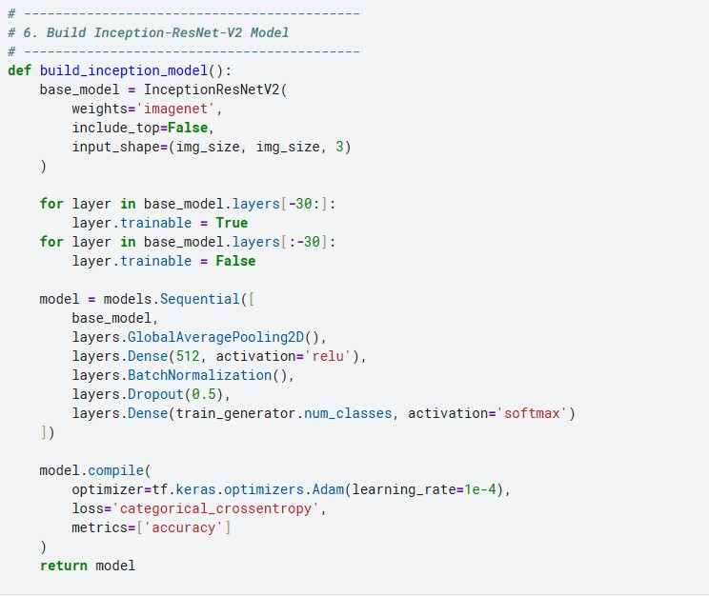
Practical application
50

Slide 51
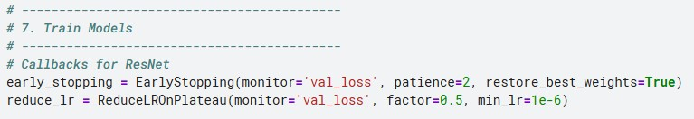
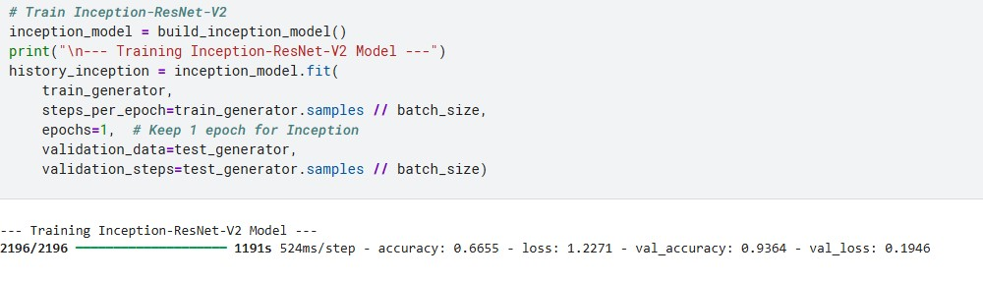
Practical application
51

Slide 52
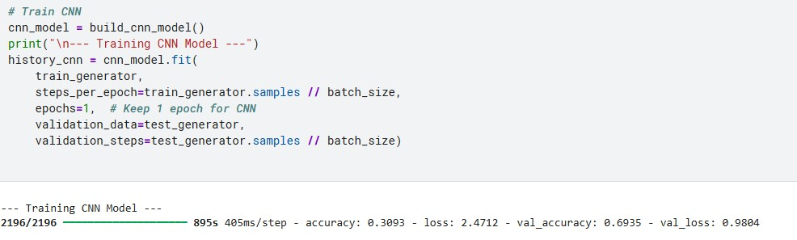
Practical application
52

Slide 53
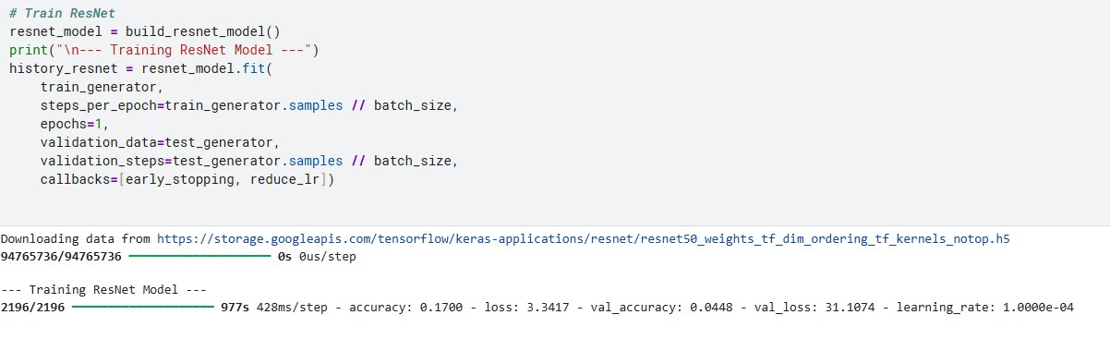
Practical application
53

Slide 54
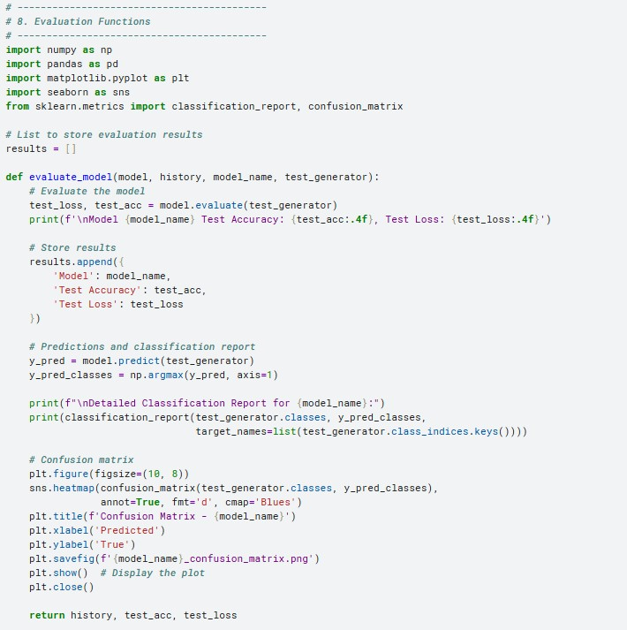
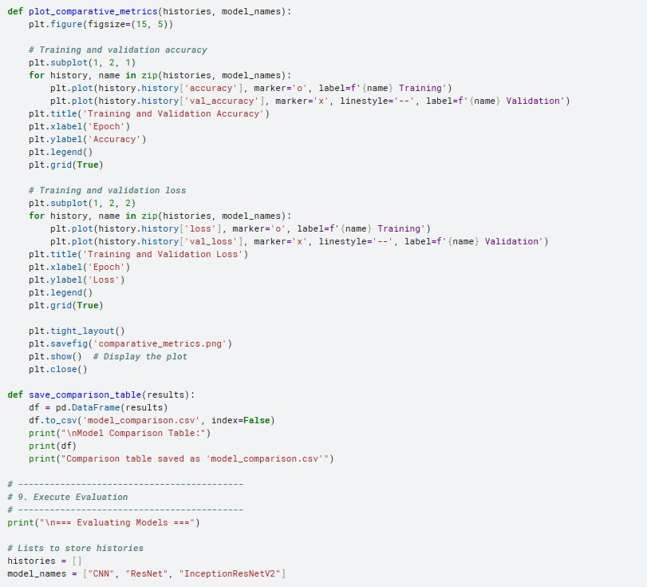
Practical application
54

Slide 55
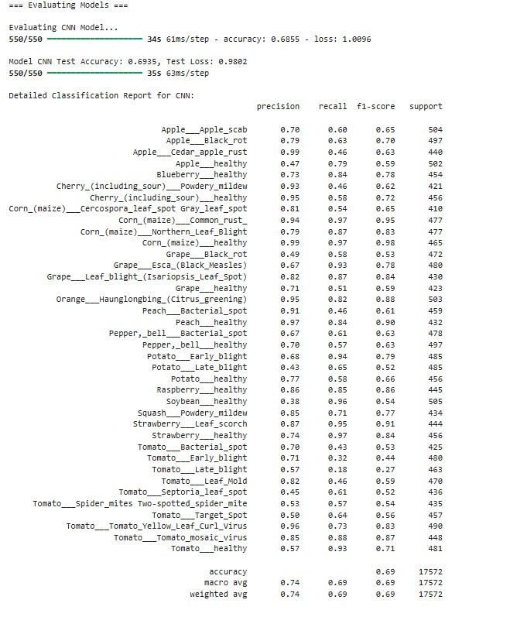
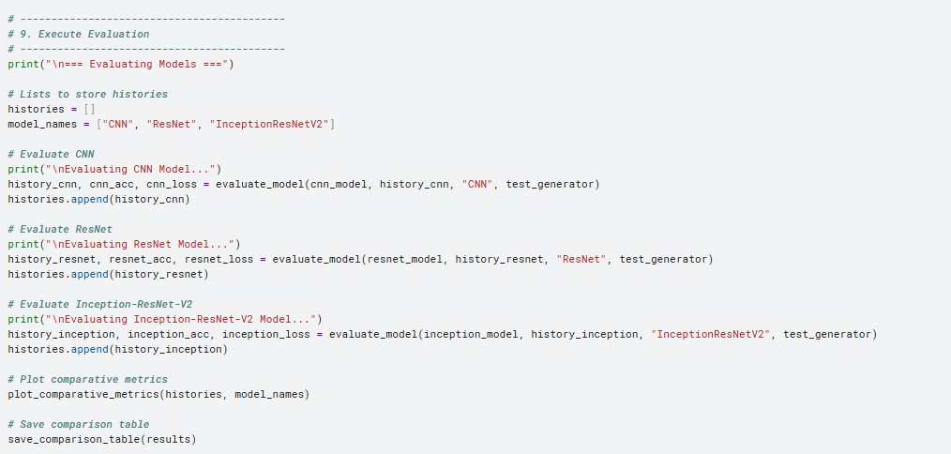
Practical application
55

Slide 56
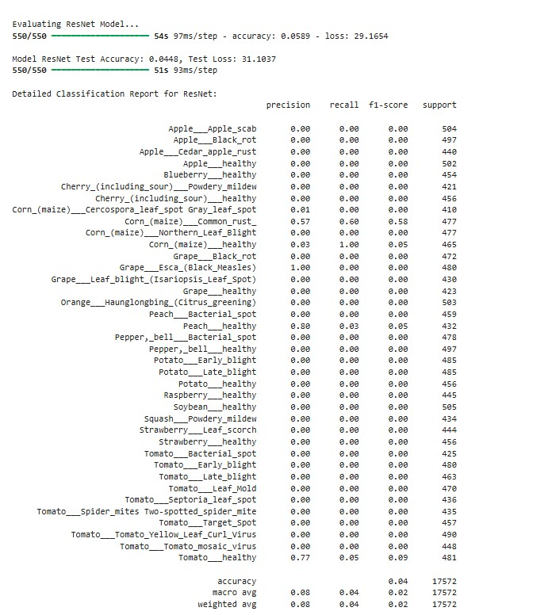
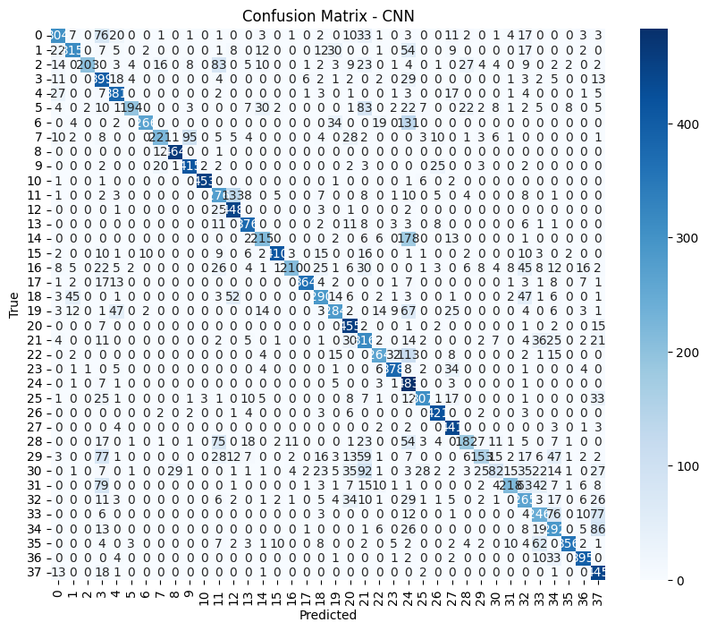
Practical application
56

Slide 57
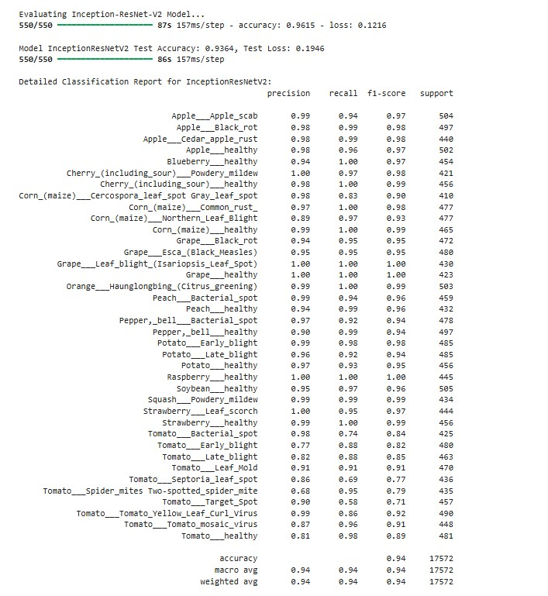
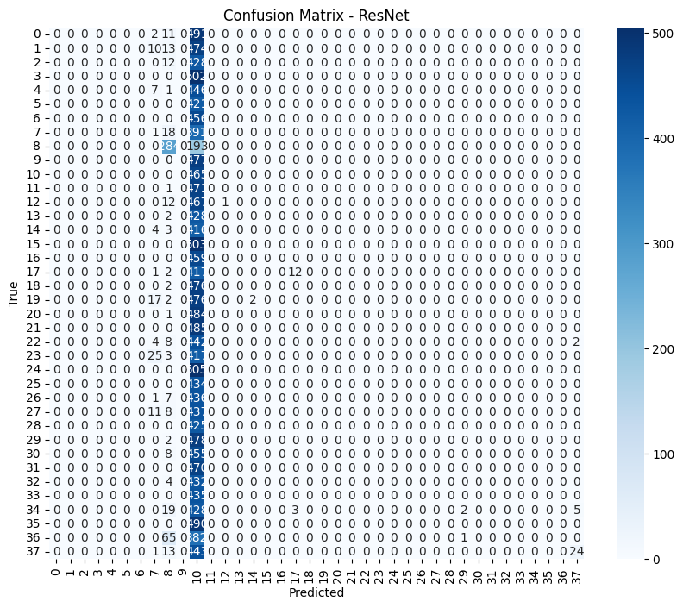
Practical application
57

Slide 58


Practical application
58

Slide 59

Practical application
59

Slide 60
Practical application
60

Slide 61


Practical application
Inception-ResNet-V2 (Epoch=3)
61

Slide 62


Practical application
Inception-ResNet-V2 (Epoch=3)
62

Slide 63


Practical application
Inception-ResNet-V2 (Epoch=3)
63

Slide 64


Practical application
Inception-ResNet-V2 (Epoch=5)
64

Slide 65


Practical application
Inception-ResNet-V2 (Epoch=5)
65

Slide 66


Practical application
Inception-ResNet-V2 (Epoch=5)
66

Slide 67
67
CONCLUSION

Slide 68

Conclusion
"This study showed deep learning (InceptionResNetV2) effectively detects plant diseases from leaf images, achieving high accuracy rapidly using a diverse dataset and data augmentation."
Key Points Retained:
Disease detection via inceptionresnetv2.
Critical methods (dataset diversity + augmentation).
Efficiency high accuracy with minimal training.
68

Slide 69
Conclusion
Importance
The integration of AI into agriculture opens new doors for early disease detection, leading to:
Increased crop productivity
Reduced economic losses
Improved food security
Deep learning models like InceptionResNetV2 have the potential to revolutionize plant health monitoring, making agriculture more intelligent, scalable, and sustainable.
69

Slide 70


Thank You

